Slide 1
Automated Phissing Email Detection and Reporting System
Supervised by:
Taghreed Salem

Slide 2
Table of Contents
Introduction
Motivation
System Overview
Similar Systems
What Makes Our System Unique?

Slide 3
Introduction

Slide 4
Problem Statement
Phishing attacks are one of the fastest-growing cyber threats worldwide
Businesses lose millions annually due to phishing-related breaches
Many organizations lack affordable and flexible email security solutions

Slide 5
Project Idea
Develop a Phishing Email Detection System to identify phishing emails automatically.
Classify emails as Legitimate or Phishing using content and metadata analysis.
Use a hybrid approach combining:
Machine Learning
NLP techniques
Rule-based URL and header checks
Apply TF-IDF for feature extraction from email text.
Use classical ML algorithms (Logistic Regression, Naive Bayes, SVM, Random Forest).
Implement a multi-stage detection engine to improve accuracy and robustness.
Provide real-time results with confidence scores and explanations.
Offer a web-based interface with persistent scan logging.
Deliver a lightweight, explainable, and practical phishing detection solution.

Slide 6
Project Motivation

Slide 7
Scientific Perspective
Research Gaps Addressed
Limited use of hybrid detection approaches combining machine learning with rule-based analysis.
Lack of explain ability in many phishing detection systems, reducing trust and usability.
Poor generalization to unseen, real-world emails due to overfitting on benchmark datasets.

Slide 8
Scientific Perspective
Scientific Support & Relevant Studies
Research shows that TF-IDF combined with classical ML algorithms (SVM, Random Forest, Logistic Regression) performs effectively in phishing detection.
Studies confirm that URL-based lexical features significantly improve phishing detection accuracy.
Literature reviews highlight that hybrid systems outperform single-technique models in handling evolving phishing strategies.
Existing research emphasizes the need for lightweight, interpretable, and deployable phishing detection systems for practical use.

Slide 9
Market Perspective
Market Demand & Trends
Rapid growth in phishing and social engineering attacks.
Increasing use of AI-generated phishing emails.
High demand for affordable and easy-to-deploy email security solutions.
Growing interest in explainable cybersecurity systems.
Impact & Benefits
Reduces phishing-related risks and losses.
Improves user awareness and trust.
Provides real-time, transparent email protection.
Suitable for organizations, universities, and individuals.

Slide 10
System Overview Diagram

Slide 11
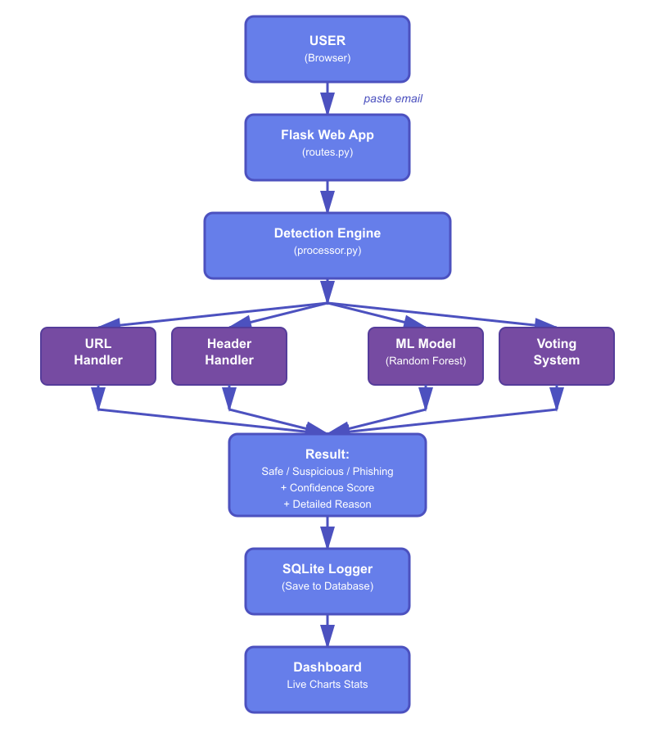
System Overview
User Input Layer
Flask Web Application (routes.py)
Detection Engine (processor.py)
Four Parallel Detection Handlers
Result Generation
SQLite Logger (logger.py)
Dashboard & Visualizationa

Slide 12
Similar Systems

Slide 13
Similar System (1) (2) (3)
System #1: PhishHaven (2020)
What it does:
Detects AI-generated phishing URLs using ensemble ML
Features:
10 parallel ML models (SVM, Random Forest, etc.)
Very high accuracy on phishing URLs
Analyzes URL structure and patterns
Limitations:
URL-only (ignores email content)
No header analysis
Misses text-based phishing

Slide 14
Similar System (1) (2) (3)
System #2: BERT + LSTM Model (2023)
What it does:
Deep learning with transformer architecture
Features:
Near-perfect accuracy (highest in field)
Advanced NLP for text understanding
State-of-the-art technology
Limitations:
Requires expensive GPU
Black box (no explanations)
Slow (5-10 seconds per email)
Hard to maintain

Slide 15
Similar System (1) (2) (3)
System #3: PhishNet-NLP (2024)
What it does:
NLP-based with semantic analysis
Features:
Excellent detection rate with minimal false alarms
WordNet semantic processing
Multi-layer analysis
Limitations:
English-only
Fails on short emails
No attachment scanning
Complex setup

Slide 16
What Makes Our System Unique?
We check URLs AND email content
Works on regular computers (no GPU needed)
Explains WHY something is phishing
Works with short emails
Has a beautiful dashboard
Stores all results for auditing

Slide 17
Prototype

Slide 18
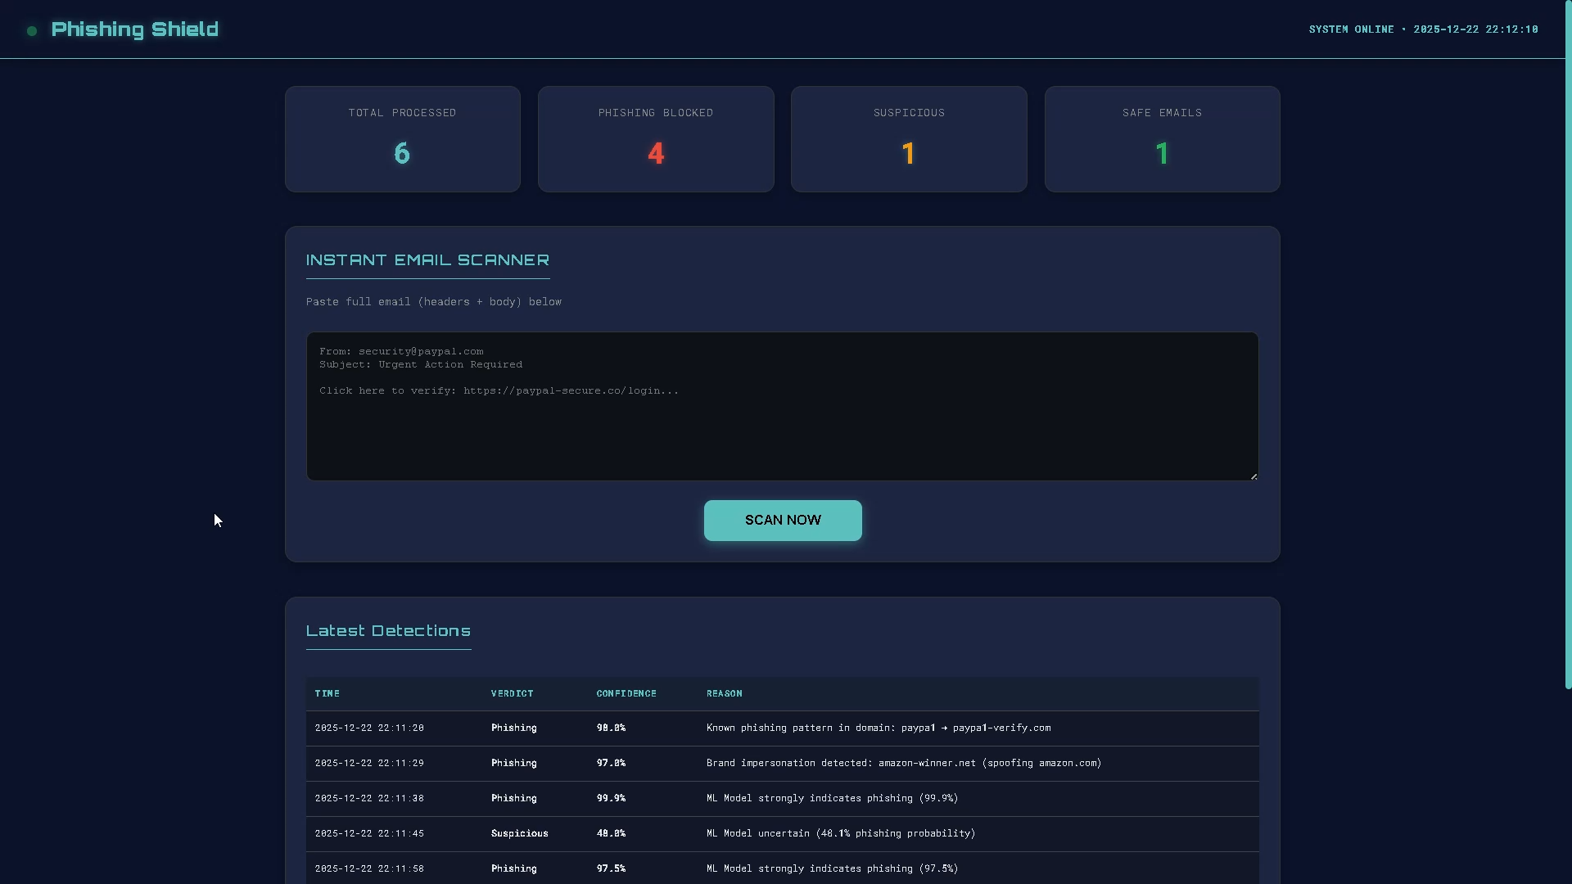
Prototype

Slide 19
Any Questions?

